Slide 1
Presentations
Effective communication to an audience
Dr Kevin McManus

Slide 2
Why?
Because the COMP1715 coursework 2 specification is out and you are about to prepare and deliver a stand up presentation
Key to presenting is
  Focus and prioritise
  Clean, clear, concise slides
  Body language
  Practice

Slide 3


Slide 4
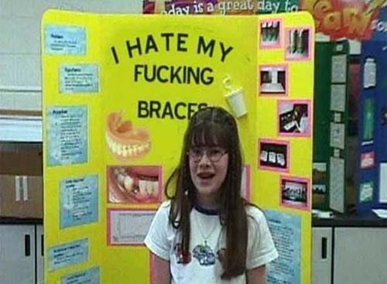
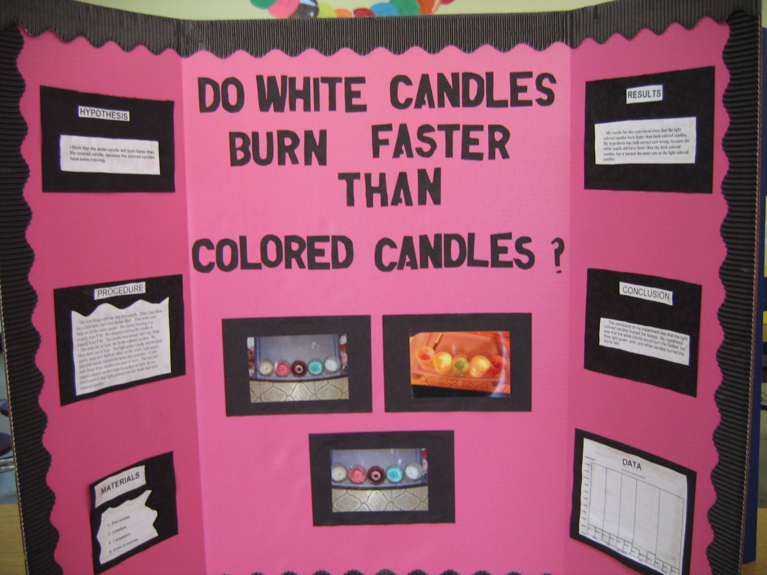
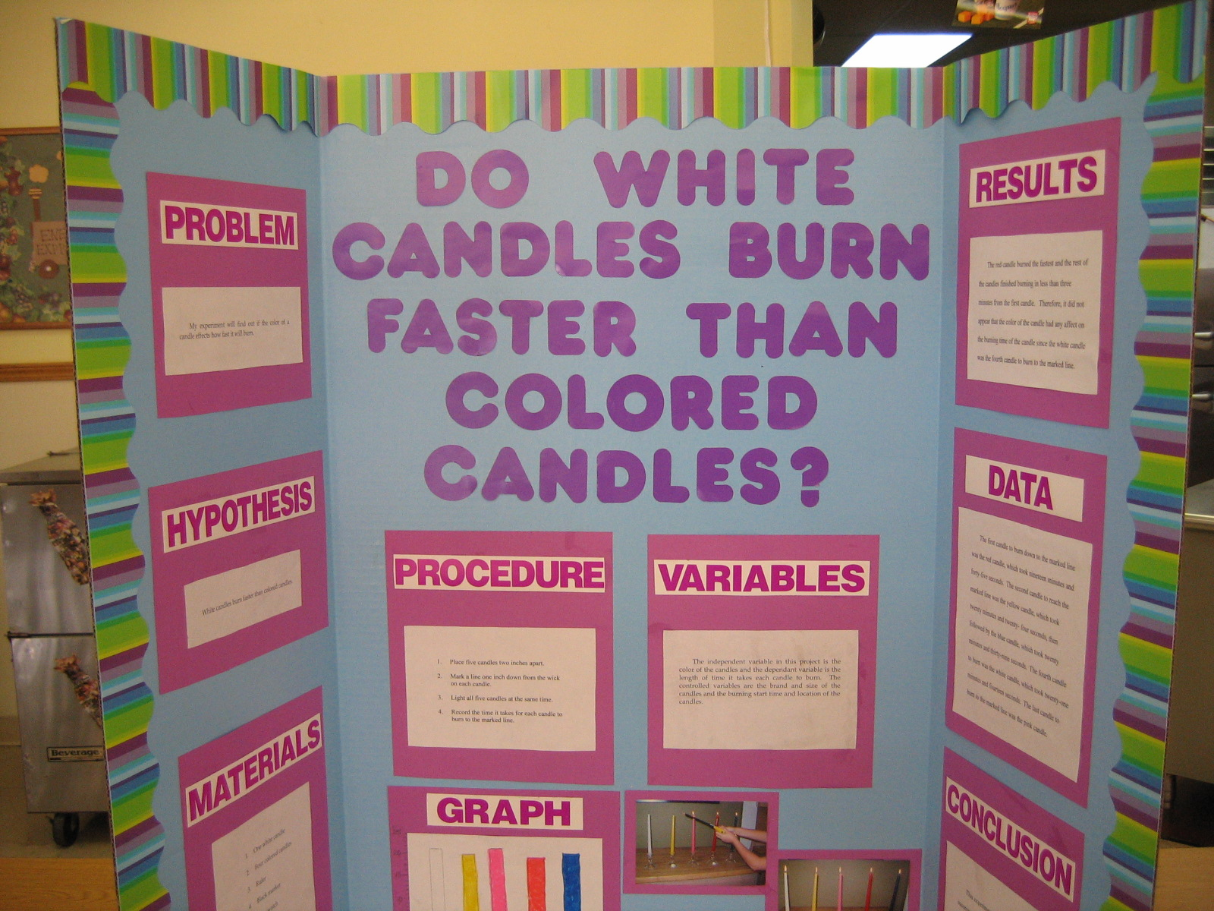
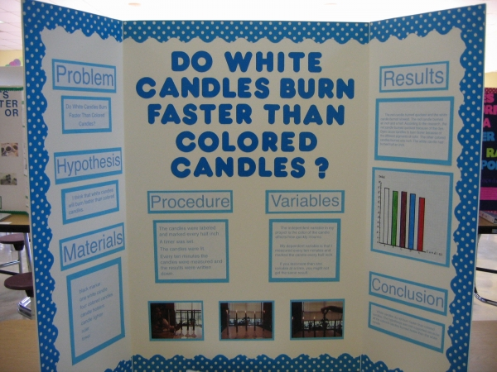

Slide 5
It is your slideshow
Have a clear structure
  say what you are going to talk about
  talk about it
  remind the audience what you have just told them
Establish your subject and focus on it
  consider your audience and purpose
  repeat your main points
Keep the slides clear, clean, concise and simple
  figures, graphs, diagrams and so on can be good
  minimise decoration and animation
  use a 4 × 3 aspect ratio
    unless you know that a widescreen projector will be available
Time each section
  practice and rehearse
    do not read from a script
Think professionally
  be prepared and suitably attired
  arive with a loaded thumb drive
Know what you are talking about
Do not recite the slides to the audience
The audience can read for themselves

Slide 6


Published 1967
image © Aviditii Empowerment Asia

Slide 7
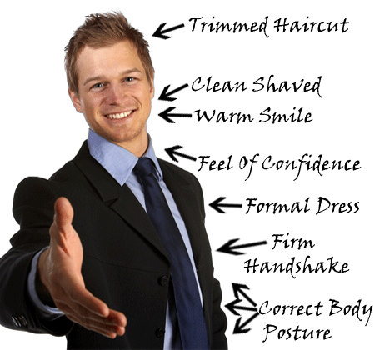
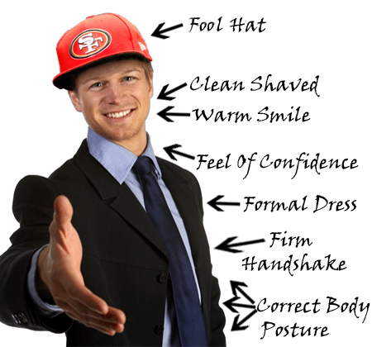
Would you buy a used car from this person?
image © Habib Khoury

Slide 8
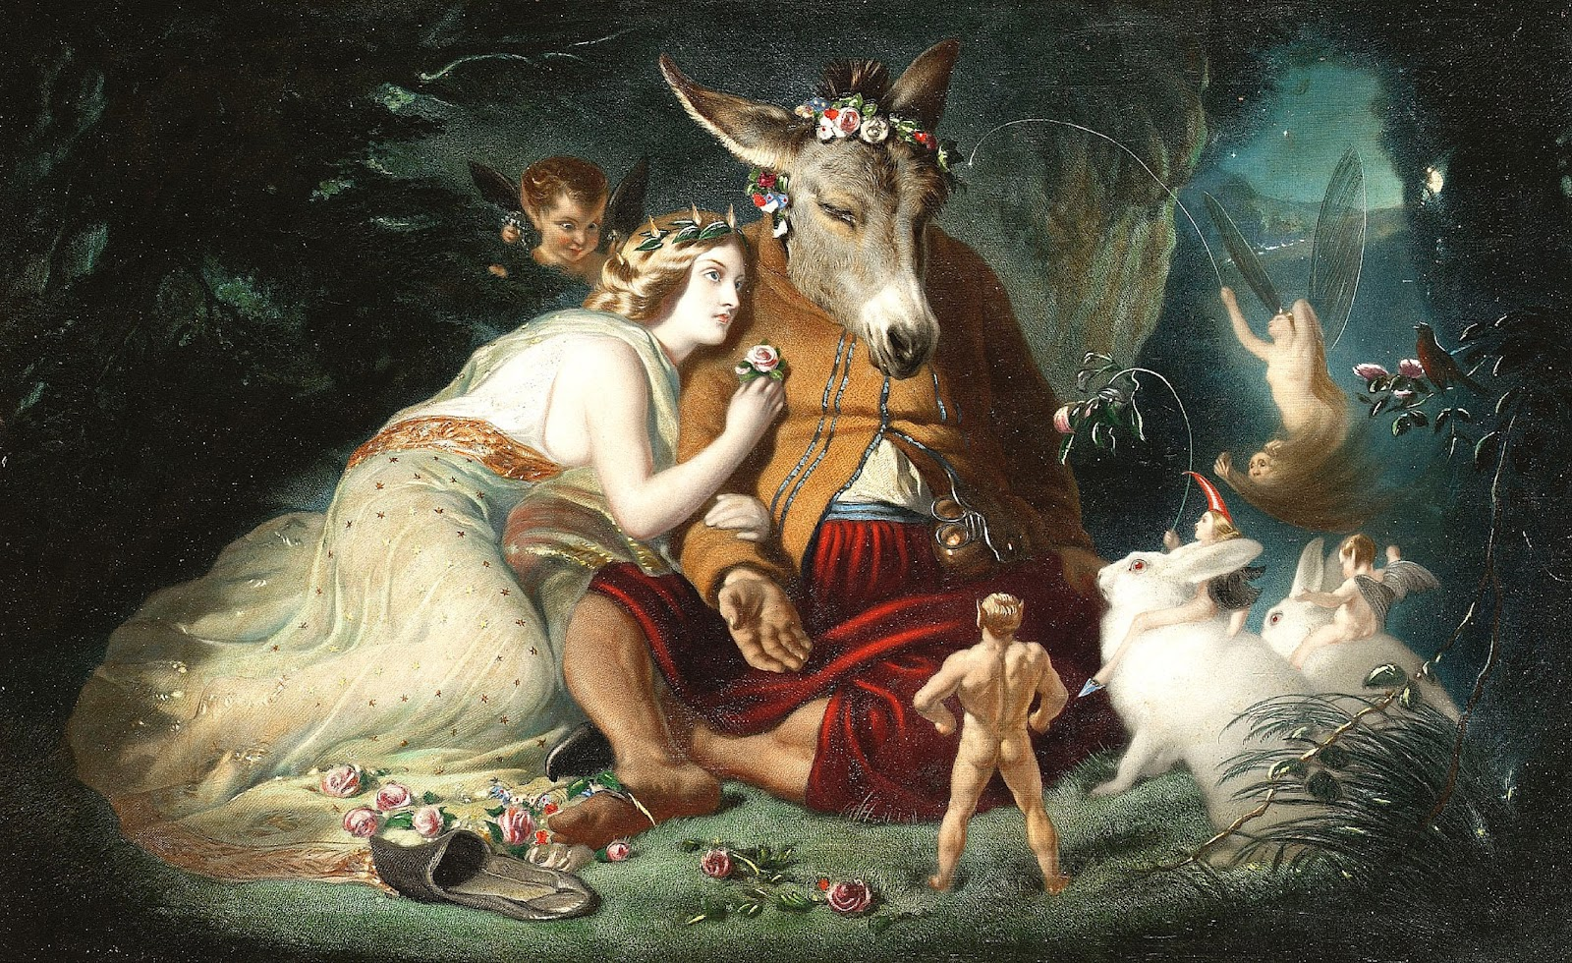
Landseer 1851 oil-on-canvas

Slide 9
21st Century Undergraduate Curricula
HE study in the information age
Dr Kevin McManus

Slide 10
Motivation
Consider paths in education leading to present day undergraduate curricula
Identify and address skill gaps in the modern undergraduate student

Slide 11
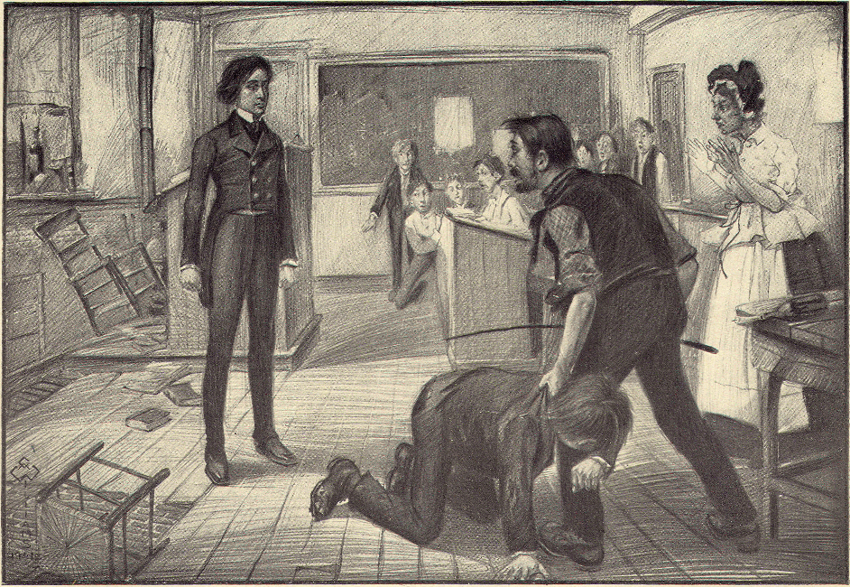
The Three 'R's
Reading
wRiting
aRithmetic
http://www.mainlesson.com

Slide 12
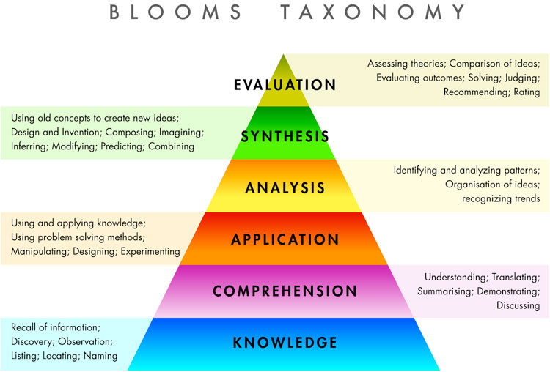
Bloom, B. et al. (1956) Taxonomy of educational objectives, www.slideshare.net

Slide 13
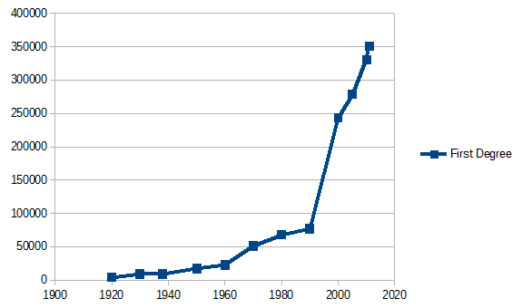
UK Undergraduate Degrees Awarded
Bolton, P, (2012) Education: Historical statistics, House of Commons Library

Slide 14
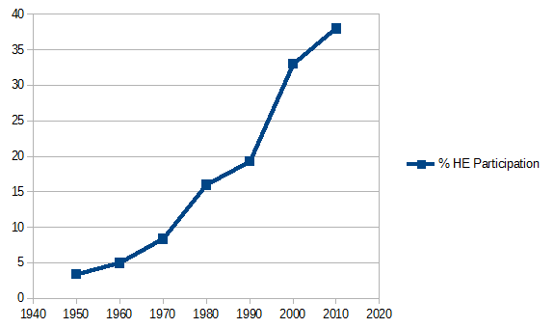
UK Participation in Higher Education
Bolton, P, (2012) Education: Historical statistics, House of Commons Library

Slide 15
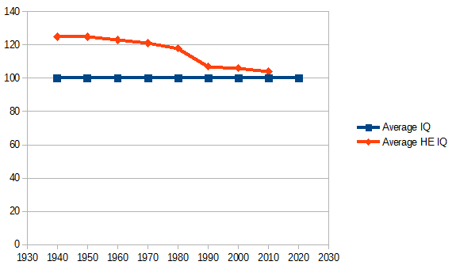
UK Average IQ of Undergraduate
This may be made up data but it is a logical conclusion from the previous graphs

Slide 16
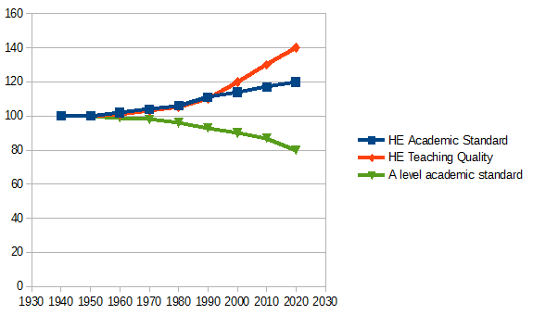
UK Academic Standard
Where is my evidence for this?

Slide 17
Skill Gap
Manifest in poor performance in assignments
  especially essay based and FYP
Lack of basic skills for HE study
  3 Rs + high order cognitive skills
Blame the information age?
  knowledge has never been so readily available
Students now have greater breadth of knowledge
  arguably superficial
    less focus
  lower reliance on memory
    impact on higher order cognitive skills

Slide 18
Addressing the Skill Gap
COMP1632 Systems Development Project
  level 5
COMP1715 Scholarly and Academic Practice
  level 4
Assessment and Qualifications Alliance Extended Project Qualification
  level 3

Slide 19
Summary
Skills gap results from
  maintaining (improving) HE academic standards
  high proportion of population entering HE
  level 3 grade inflation
  pervasive information technologies
Solution is to
  recognise the problem
  adapt the curriculum to support students

Slide 20

Questions

Slide 21
Summary
When giving a presentation
  Focus on your core message
  Slides should be clear, uncluttered
    less is more
    numbers, data, graphs, and so on are good
    pictures are good
      and avoids you simply reading your slides to the audience
  Body language
    appropriate dress code
    annunciate clearly
  Watch the clock
    practice your timing
  Professional
    the show must go on

Slide 22
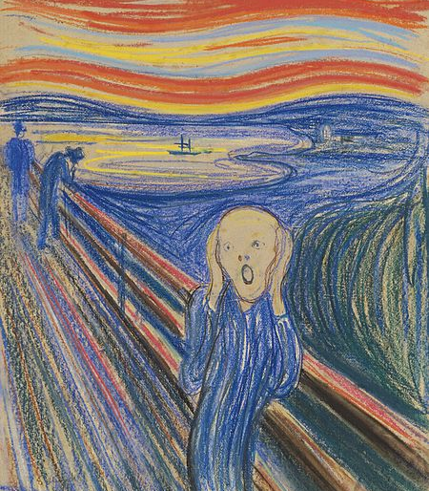
Questions

